Slide 1
Step –By-Step: How to Enter CEUs
September 2013

Slide 2
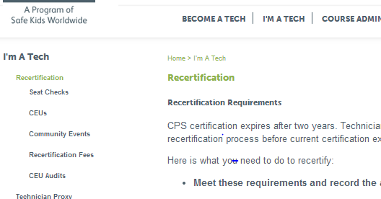
Details Online http://cert.safekids.org → I’m A Tech/Recertification

Slide 3
Re-certification Requirements
Basic re-certification requirements and deadlines
Five seat checks approved by a certified instructor (may use technician proxy option)
Community Education
A minimum of six hours of CPS technical continuing education (CEUs)
Register and pay fee by the end of the certification expiration date.
INSTRUCTORS: In addition to the above requirements, you must also log 20 teaching hours of CPS course instruction.
Personal log available under Resources: Forms

Slide 4
Continuing Education (CEU)
A minimum of six hours of CPS technical continuing education (CEUs) must be obtained and reported during the current certification cycle.
They may be entered at any time during your certification cycle.
CEUs must fit into one of the five approved categories and meet content requirements.

Slide 5
Go to http://cert.safekids.org
Click on LOG IN

Slide 6
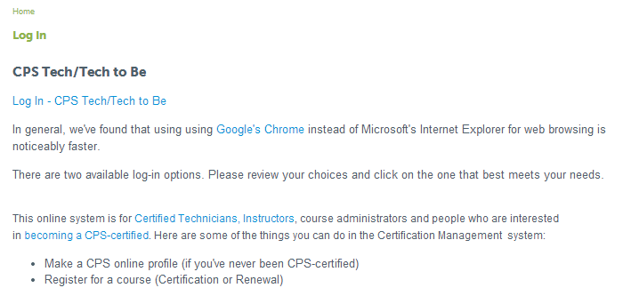
Click on Tech/Tech to Be

Slide 7
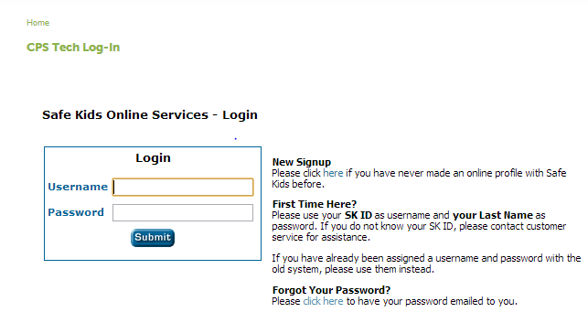
Log In
Need help?
Call Customer Service: 877-366-8154.

Slide 8
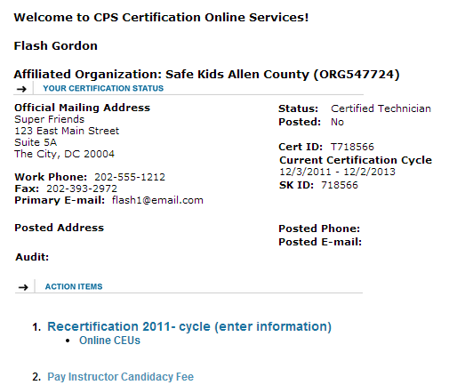
Review Your Action Items

Slide 9
Reviewing Recert Requirements
Click on Recert…

Slide 10
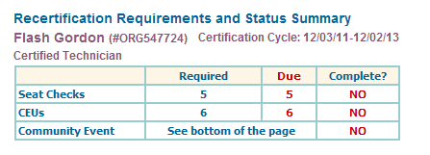
Reviewing Recert Requirements
Top of Page

Slide 11
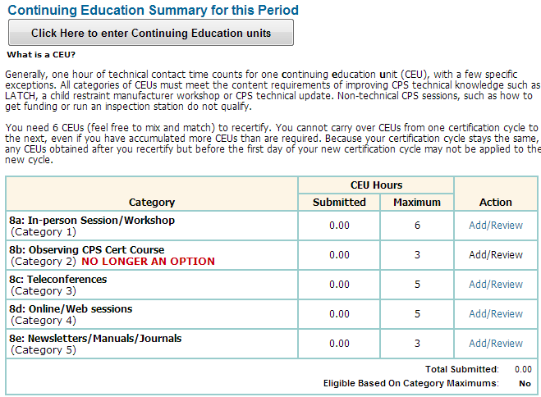
Entering CEUs
Click on either option

Slide 12
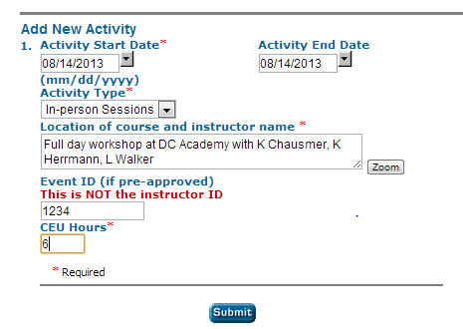
Entering CEU Detail

Slide 13
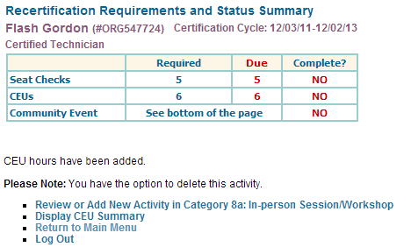
CEU confirmation screen

Slide 14
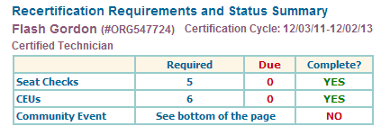
Summary Page

Slide 15
Contacting CPS Customer Service
(877) 366-8154
cps.certification@safekids.org
Certification-related information
is available at http://cert.safekids.org.

