Slide 1
Step-By-Step: How to Register for a Public Course (paying by credit card)
April 2016

Slide 2
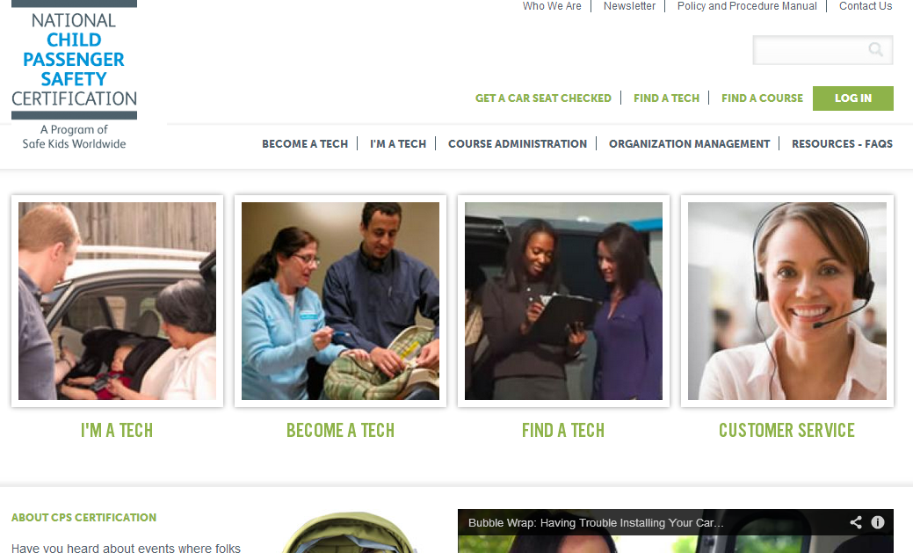
Go to http://cert.safekids.org
Click on LOG IN

Slide 3
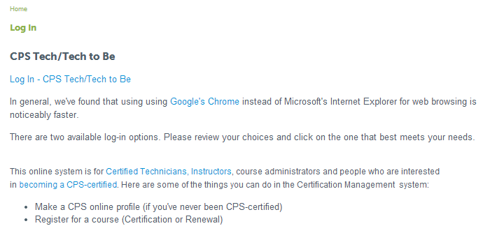
Click on Tech/Tech to Be

Slide 4
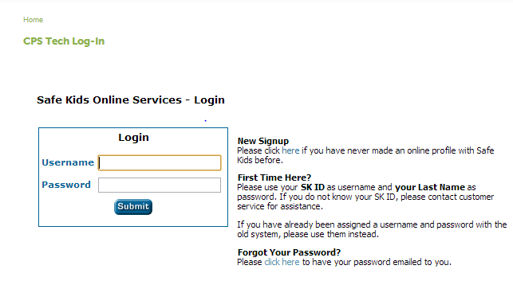
Log In
Need help?
Call Customer Service: 877-366-8154.

Slide 5
Need Your Log-in Info?
Click on Forgot Your Password link or call 1-877-366-8154.

Slide 6
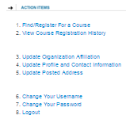
Click on Find/Register For A Course

Slide 7
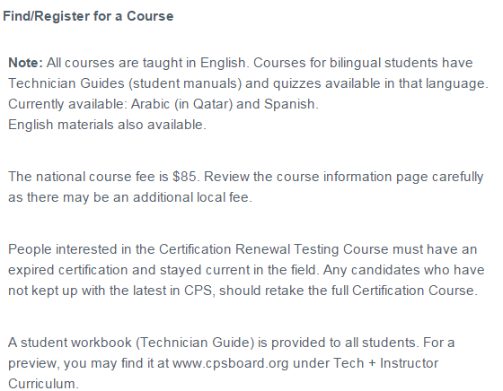
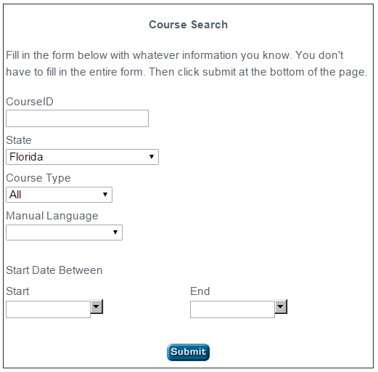
Search for the Course
This is using Florida as a Example

Slide 8
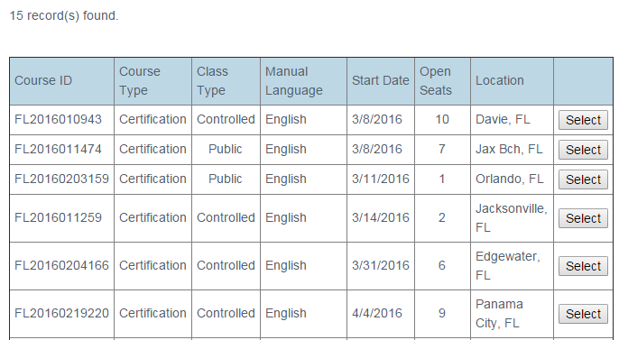
Choose the Course
Public Courses are available on a first come-first served basis. (Paying the fee gets you in.)

Slide 9
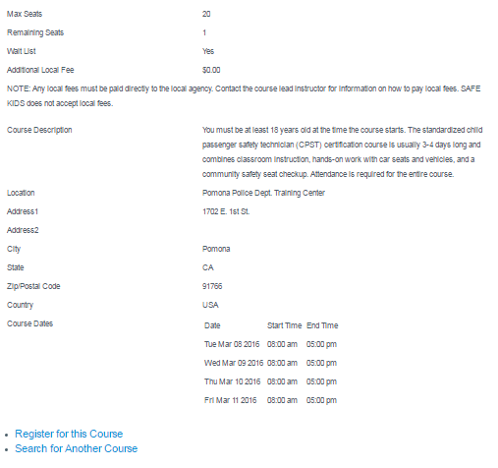
Review Course Details
Note any locally paid additional fees.
Register and make payment.

Slide 10
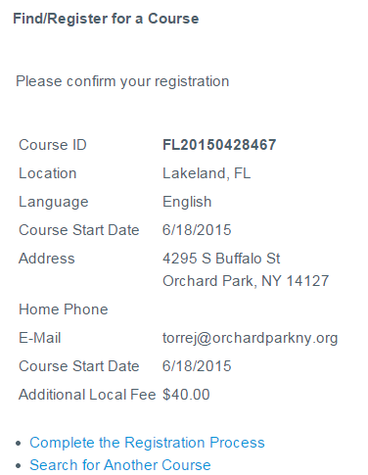
Confirm Course

Slide 11
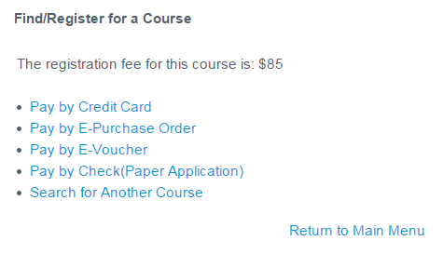
Select Payment Method
These 2 options show up if you are Affiliated with an Organization.
This example is credit card.

Slide 12
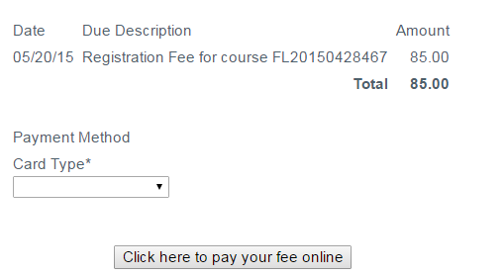
Follow Prompts/Enter Information
American Express
Visa
MasterCard Discover

Slide 13
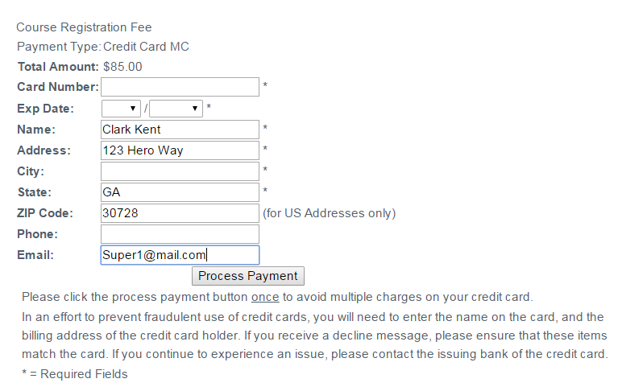
Enter Information

Slide 14
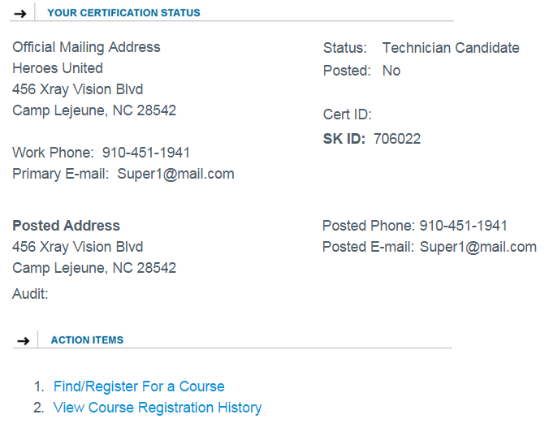
You are registered!
Status changes from Contact to Technician Candidate
To review course info, click on View Course Registration History

Slide 15
Contacting CPS Customer Service
(877) 366-8154
cps.certification@safekids.org
Certification-related information
is available at http://cert.safekids.org.

